Slide 6
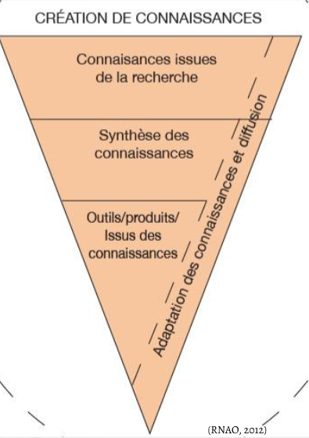

Slide 10
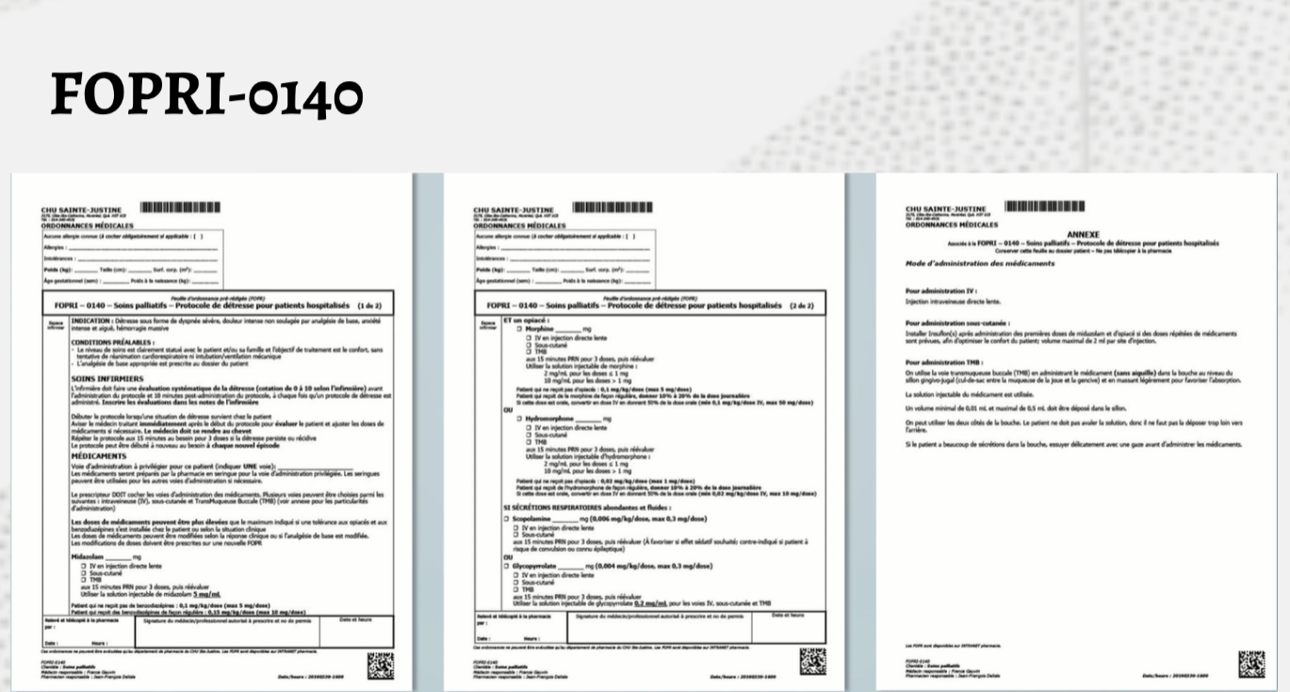

Slide 18
Ahern, K. (2013). What Neonatal Intensive Care Nurses Need to Know About Neonatal Palliative Care. Advances in neonatal care, 13(2), 108-114.
Bateman, L., Tofil, N., White, M.L., Dure, L., Clair, J.M., & Needham, B. (2016). Physician Communication in Pediatric End-of-Life Care: A Simulation Study. American Journal of Hospice and Palliative Care, 33(10). 935-941. DOI: 10.1177/1049909115595022
Bidet, G., Daoust, L., Duval, M., Ducruet, T., Toledano, B., Humbert, N., & Gauvin, F. (2016). An Order Protocol for Respiratory Distress/Acute
Pain Crisis in Pediatric Palliative Care Patients:Medical and Nursing Staff Perceptions. Journal of Palliative Medicine, 19(3). 306-313. DOI: 10.1089/jpm.2015.0100
Bloomer, M., O’Connor, M., Copnell ,B., & Endacott, R. (2015). Nursing care for the families of the dying child/infant in paediatric and neonatal ICU: Nurses’ emotional talk and sources of discomfort. A mixed methods study . Australian Critical Care, 28. 87-92.
Brennan, C., &Mazanec, P. (2011). Dyspnea Management Across the Palliative Care Continuum. Journal of Hospice and Palliative Nursing, 13(3). 130-139. DOI: 10.1097/NJH.0b013e3182148314
Campbell, M. (2015). Caring for Dying Patients in the Intensive Care Unit. Advanced Critical Care, 26(2). 110-120
Contro, N.A., Larson, J., Scofield, S., Sourkes, B., & Cohen, H.J. (2004). Hospital Staff and Family Perspectives Regarding Quality of Pediatric Palliative Care. American Academy of pediatrics, 114(5). 1248-1252
Grimshaw, J.M., Shirran, L., Thomas, R., Mowatt, G., Fraser, C., Bero, L., Grilli, R., Harvey, E., Oxman, A., & O'Brien, M.A. (2001). Changing Provider Behavior: An Overview of Systematic Reviews of Interventions. Medical Care, 39(8).
Houlahan, K., Branowicki, P., Mack, J., Dinning, C., & McCabe, M. (2006). Can End of Life Care for the Pediatric Patient Suffering With Escalating and Intractable Symptoms Be Improved? Journal of Pediatric Oncology Nursing, 23. 45-51.
Horrock, S., Somerset, M., & Salisbury, C. (2002). Do children with non-malignant life-threatening conditions receive effective palliative care? A pragmatic evaluation of a local service. Palliative Medicine, 16. 410-416.
Jeffrey, D. (1994) Education in palliative care: a qualitative evaluation of the present state and the needs of general practitioners and community nurses. European Iournal of Cancer Care, 3,67-74
Kenny, G., Cargil, J., Hamilton, C., & Sales, R. (2016). Improving and validating children’s nurses communication skills with standardized patients in end of life care. Journal of Child Health Care, 20(2), 145-152. DOI: 10.1177/1367493514555588
Latha et al. (2013). The Need of Pediatric Palliative Care Education Among Pediatric Postgraduates in South India. Indian Journal of Pediatrics, 81(5), 455-459. DOI: 10.1007/s12098-013-1295-1

Slide 19
Montgomery, K.E., Sawin, K., & Hendricks-Ferguson, V. (2017). Communication During Palliative Care and End of Life. Cancer Nursing, 40(2), 47-57.
Montgomery, K., Sawin, K.J.,& Hendricks-Ferguson, V.L. (2016). Experiences of Pediatric Oncology Patients and Their Parents at End of Life: A Systematic Review. Journal of pediatric oncology nursing, 33(2), 85-104. Doi: 10.1177/1043454215589715
Morgan, D. (2009). Caring for Dying Children: Assessing the Needs of the Pediatric Palliative Care Nurse. Journal of pediatric nursing, 35(2). 86-90
Mullen, J.E., Reynolds, M.R., Larson, J.S. (2015). Caring for Pediatric Patients’ Families at the Child’s End of Life. Journal of pediatric care, 35(6). 46-55. doi: http://dx.doi.org/10.4037/ccn2015614
Picktock, S. (2017). Breathlessness at end of life: what community nurses should know. Journal of Cancer Nursing, 31(5). 74-77.
Pullis, B. (2013). Integration of End-of-Life Education into a Community Health Nursing Course. Public Health Nursing, 30(5), 463-467. DOI: 0.1111/phn.12063
Reinke, L., Shannon, S., Engelberg, R., Dotolo, D., Silvestri, G.A., & Curtis, J.R. (2010). Nurses‘ Identification of Important yet Under-Utilized End-of-Life Care Skills for Patients with Life-Limiting or Terminal Illnesses. Journal of Palliative Medicine, 13(6). 753-759. DOI: 10.1089/jpm.2009.0423
Roberts, K.E., & Boyle, L.A. End-of-life education in the pediatric intensive care unit. Critical care nurse, 25, 51-57.
RNAO. (2012). Trousse : Mise en oeuvre des lignes directrices sur les pratiques exemplaires (2e édition). Toronto (Ontario) : Association des infirmières et infirmiers autorisés de l’Ontario.
Smith T., Gordon T. (2009). Developing spiritual and religious care competencies in practice: A pilot of a Marie Curie blended learning event. International Journal of Palliative Nursing, 15, 86-92.
Smothers, A. & Buck, J. (2012). An Evaluation of a Practice Change to Increase Understanding of the Use of Nonpharmacological Interventions for the Treatment of Dyspnea in Hospice Patients. Journal of Hospice and Palliative Nursing, 14(8). DOI: 10.1097/NJH.0b013e31825c7b2a
Stayer, D., & Lockhart, J. (2016). Living with dying in the pediatric intensive care unit: a nursing perspective. American Journal of Critical care, 25(4). 350-356. doi: http://dx.doi.org/10.4037/ajcc2016251

